Slide 1
Automatic Deep Trimap Generation
Ayon Biswas 15110037
Meet Gandhi 15110049

Slide 2
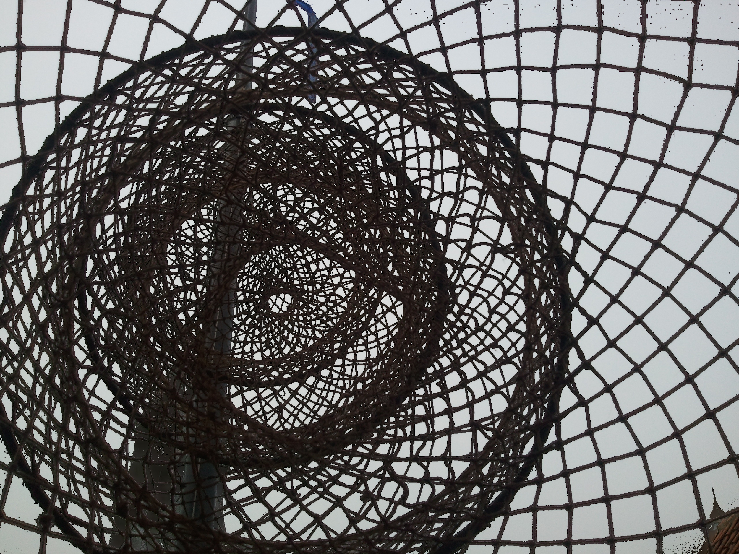
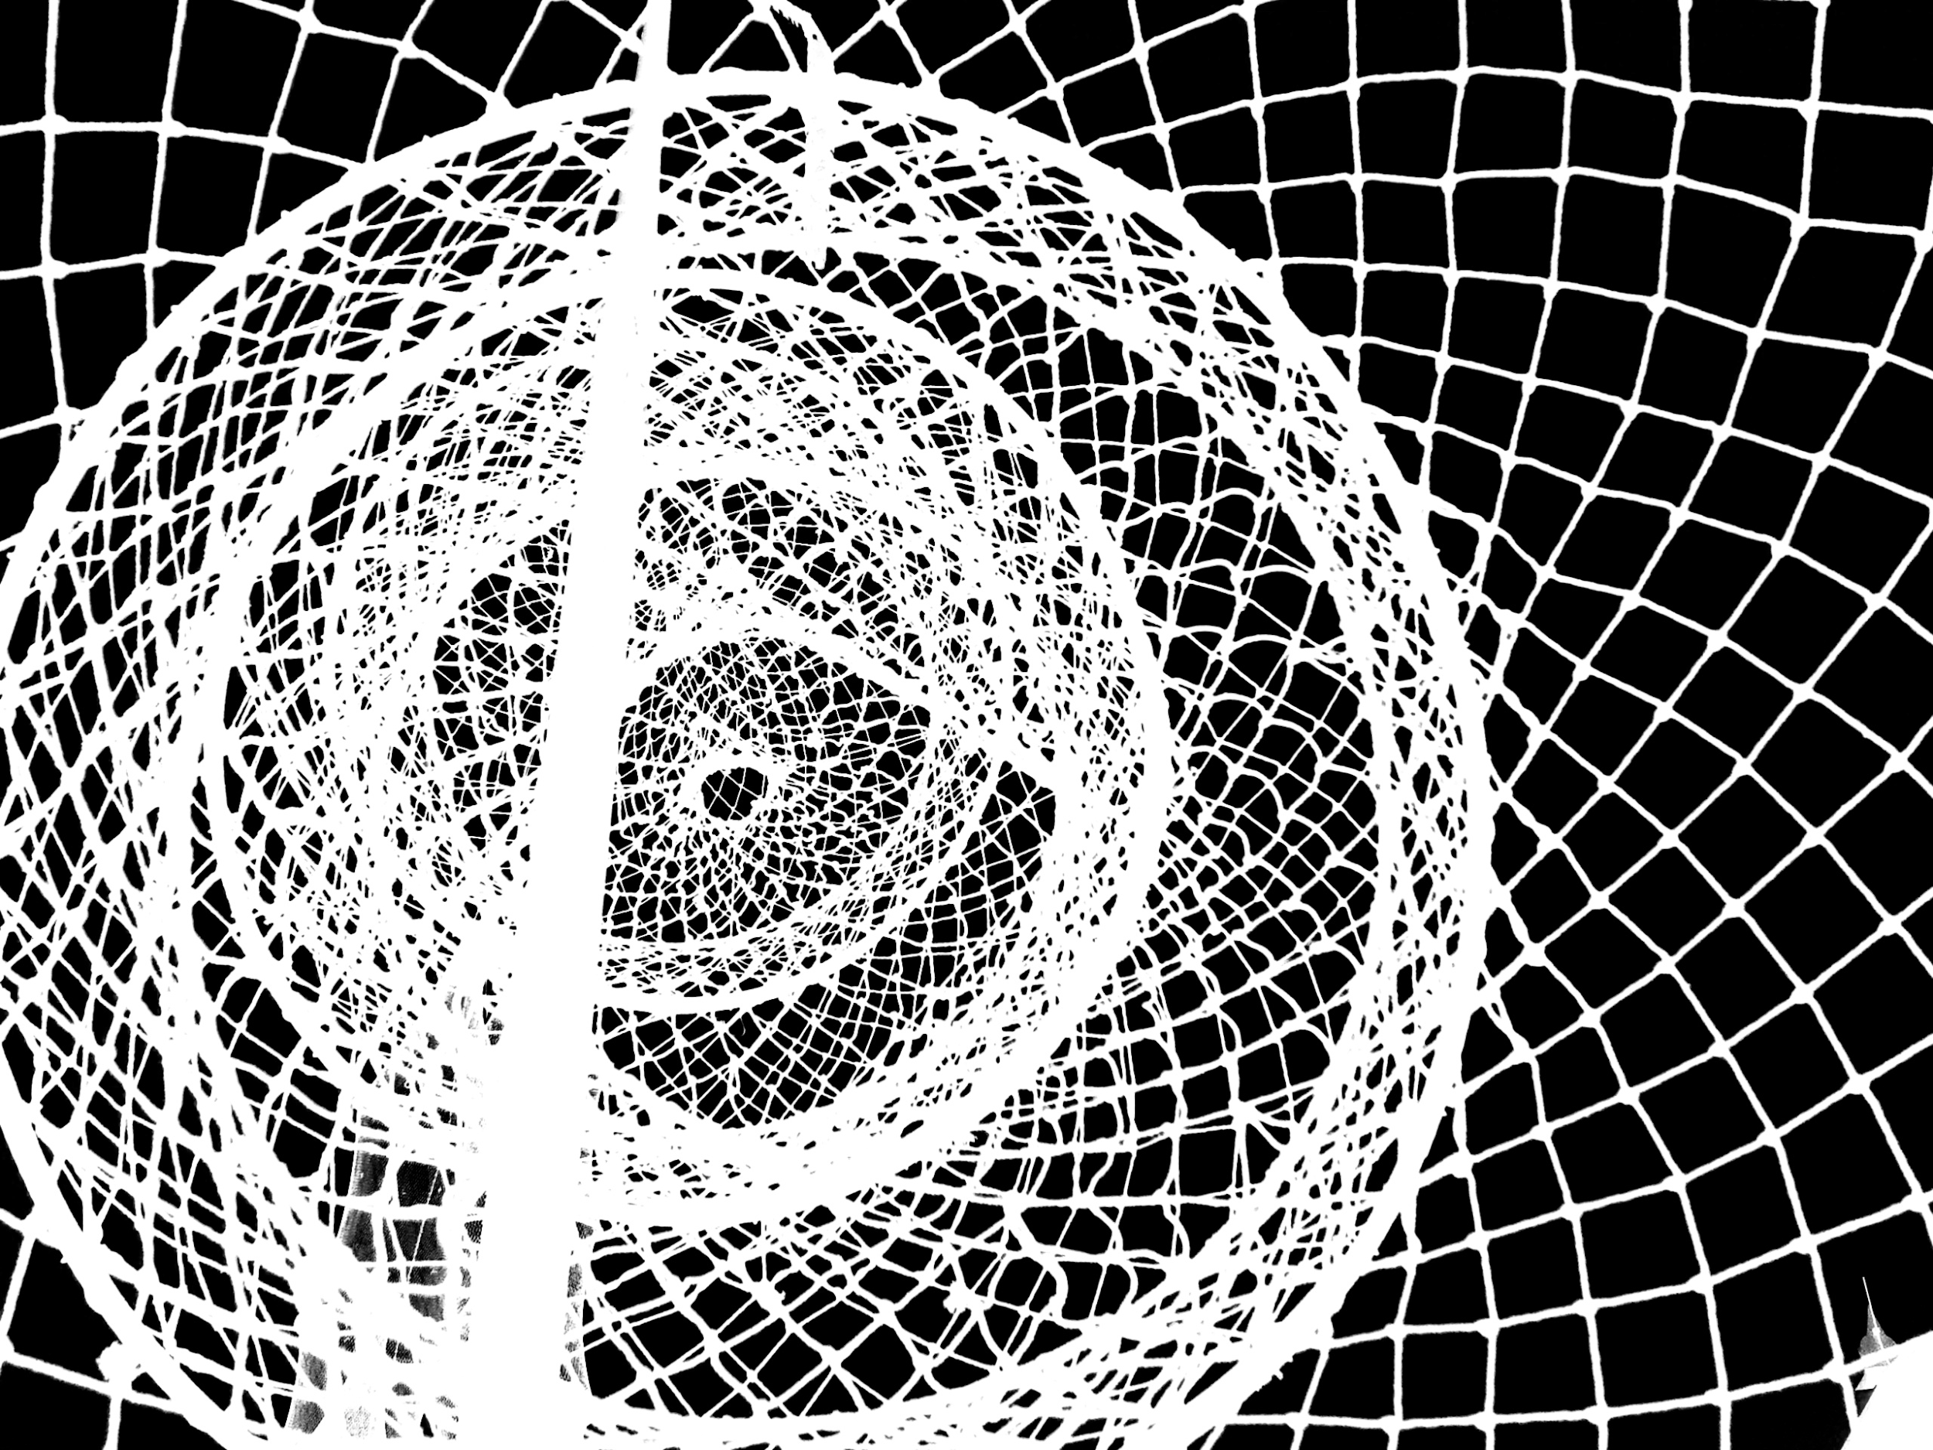
Deep Video Matting
We attempt to solve the problem of video matting using the deep learning framework.
The major challenge in video matting is the extraction of mattes along with the foreground and the background from a video accurately while being computationally fast and requiring minimal human intervention.
Deep learning framework provides us with the necessary tools to achieve faster algorithms for dealing with videos. We propose to use the Generative Adversarial Network along with long short term memory (LSTM) network in order to develop the framework for solving the video matting problem. We assume that the trimap or scribble information is available only in certain key frames of the video in the initial phase of our work.
The ultimate goal of our work is to design a deep neural network which is intelligent, user-friendly, computationally efficient and takes as input a normal video and outputs associated high quality video matte without any input of trimap/scribbles.
Notes:
arXiv:1703.03872

Slide 3
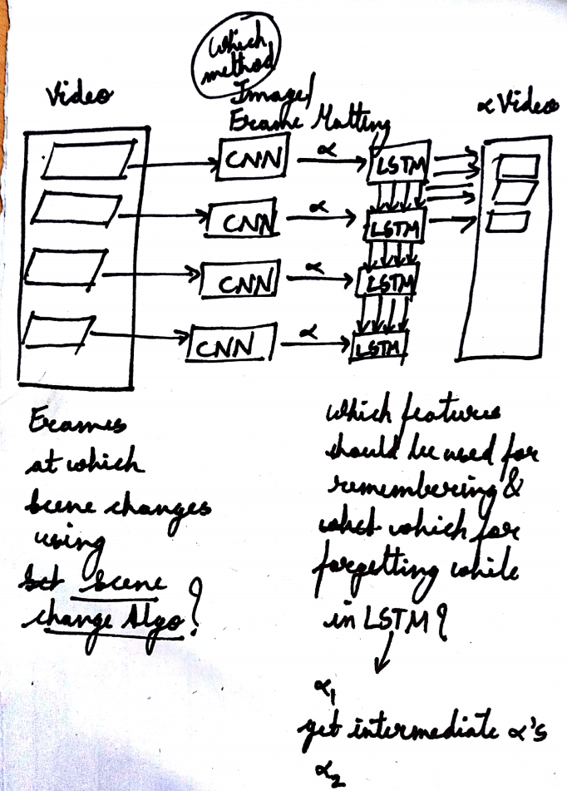
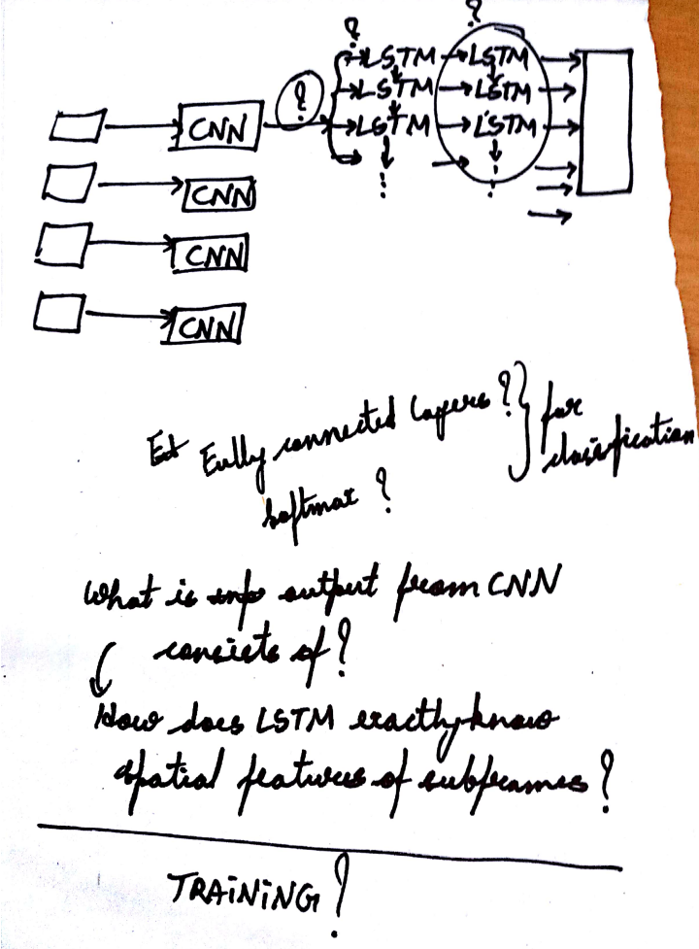
Our Methodology

Slide 4
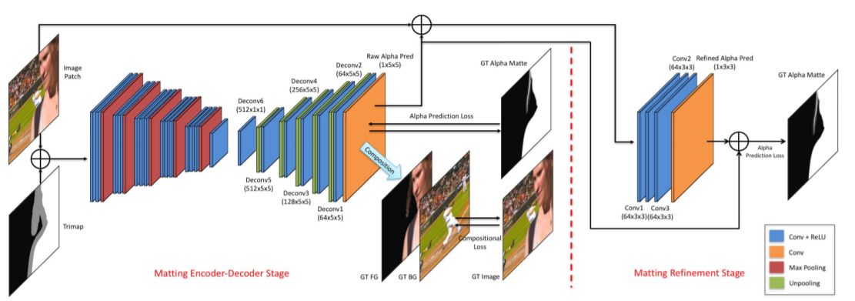
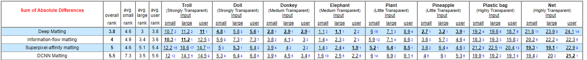
Literary Review for choosing the Perfect Image Matting Approach
Notes:
arXiv:1703.03872
http://alphamatting.com/eval_25.php

Slide 5
Goal for CS 399: Automatic Trimap Generation
For our Ultimate Goal of Deep Video Matting, once the significant frames are identified by Scene/Shot Detection Algorithm based on the dynamic motions in the video; we need to generate alpha mattes of these significant frames for which we need to input the significant frame and its Trimap to the Image Matting Approach.
The user expects to input just the Video as an input and get its respective Video Matte as an output from Deep Video Matting Approach hence we need to devise an approach through which a Deep Neural Network can automatically generate Trimap for the given image.

Slide 6
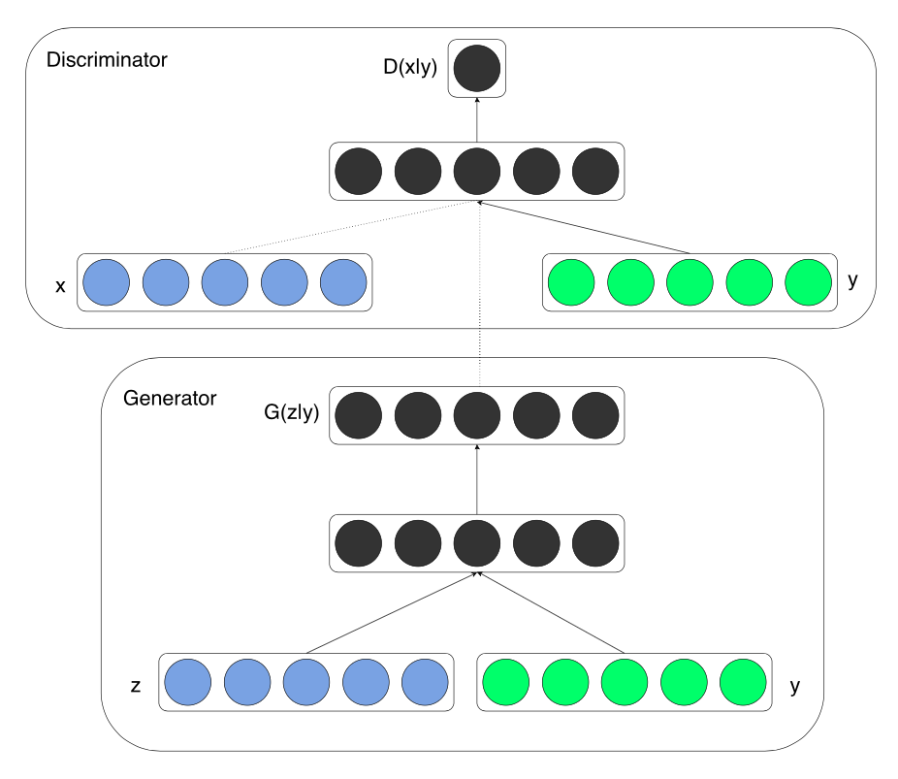
Literary Review for choosing the Automatic Trimap Generator
Condition on input noise vector
Task specific
DC gan
Cgan
ID -Cgan
SR -Gan
General purpose
Pix2pix
cyclegan

Slide 7

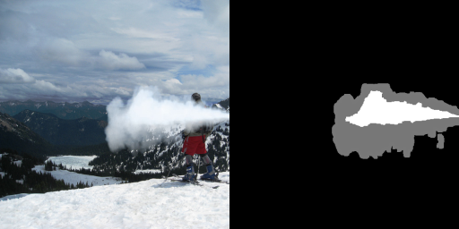
Dataset Generation
Used the adobe Image Matting dataset. Expanded the dataset by composition using alpha matte on standard datasets like CIFAR 10 , pascal VOC.
Trimaps were produced by dilation and erosion of alpha mattes.
Our code for generating Trimap: https://drive.google.com/open?id=0B9OzNe1Ao_ZpQl9mTmZIcGFfa1U
Notes:
https://arxiv.org/abs/1703.03872

Slide 8
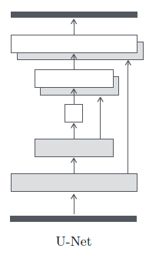
Pix2Pix
General purpose Cgan - image to image translation
Generator -Unet, Discriminator - patch gan
Loss = linear combination of Cgan objective and L1 distance
L1 - low frequency, patch gan - high frequency structure
Both generator and discriminator use modules of the form convolution-BatchNorm-ReLu

Slide 9
Our Methodology
Tested on pix2pix and cycle GAN
Network based on pytorch
Dataset for Pix2Pix consisted of concatenated image and its respective Trimap (acts as an input to Pix2Pix).
Epoch -200
Batch size - 1
Dataset size - 4200
Trained on Nvidia Titan X 12GB GPU

Slide 10
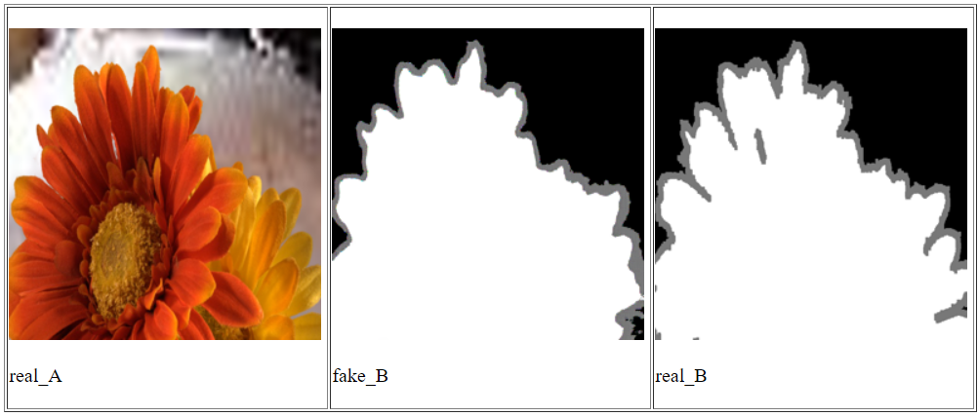
Results
Notes:
The curve in fake is more smooth than that in real which implies that it really got the curvature of the foreground correct.
In the middle part and on the right bottom side there is an unknown region in real but not in fake.

Slide 11
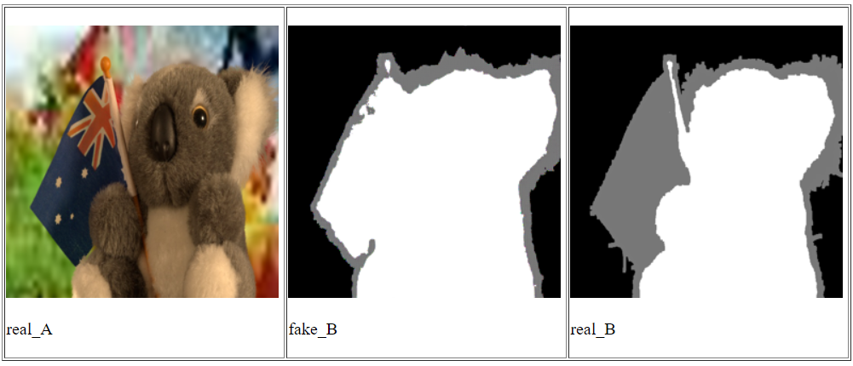
Results
Notes:
Fake is better than real as it was able to detect the flag as a part of foreground which is true.
Also in the ear side the unknown region is less in fake than in real.

Slide 12
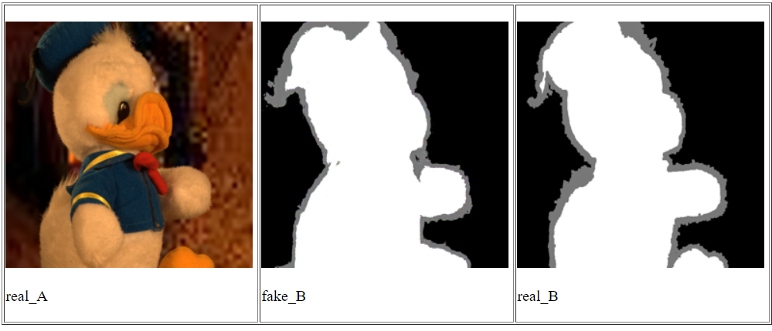
Results
Notes:
Unable to capture the hair in the tail section
Also the see the difference in near the foot.
Difference near the end of the hat not a big problem.

Slide 13
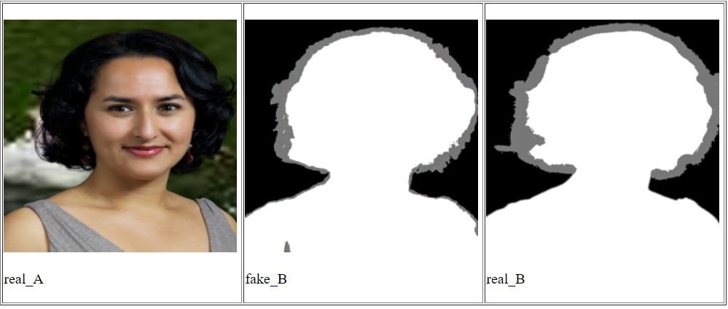
Results
Notes:
Fake has less Unknown region than real.
Also see the difference in the sudden elevation of unknown region in the left middle portion of both the images.
See the difference near the left bottom part (Unknown region).

Slide 14
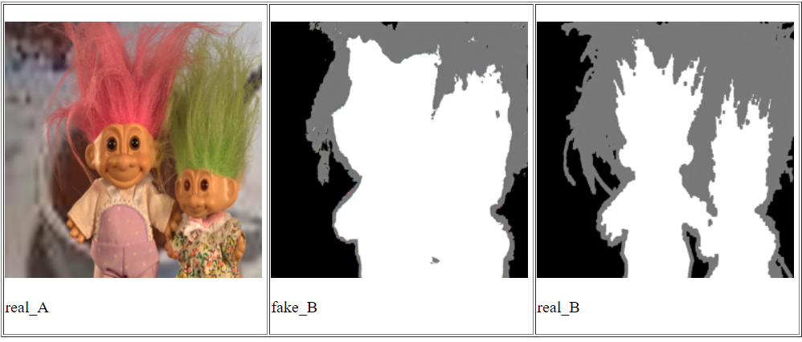
Results
Notes:
Not good enough as you can see the following regions:
Bottom middle, Middle Portion b/w heads
Foreground is not recognizable to the figure
Some hair filaments in the left middle are not taken into consideration in the fake which is there in real.

Slide 15
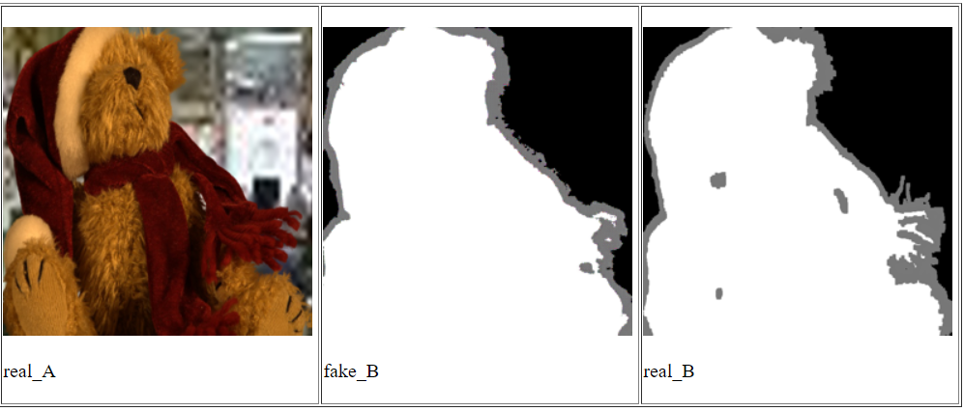
Results
Notes:
See that the hair filament is recognized wrong in real at the right middle but not in fake.
Also see the space b/w the leg and the red scarf is detected unknown properly in fake than in real.

Slide 16
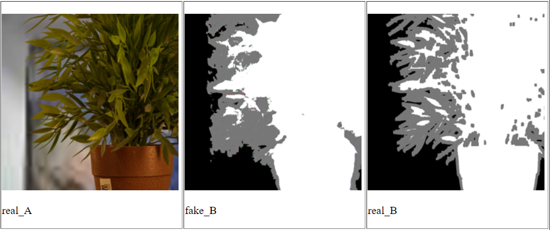
Results
Notes:
Finer details are missing in fake but visible in real.

Slide 17
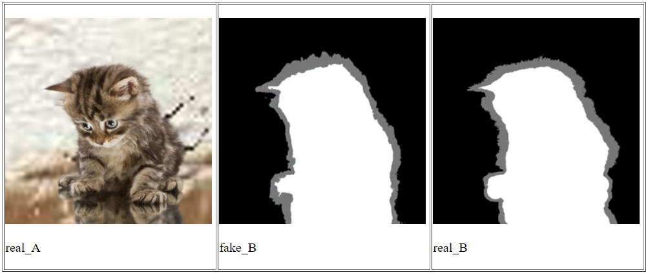
Results

Slide 18
Our Interpretation of the Results & Conclusions
Works fine for solid objects
Does not give good results for transparent, hairy like objects
Works better if object boundaries contrasts with background
Need more training
Lack of dataset of diversity
Cyclegan performs poorly than pix2pix

Slide 19
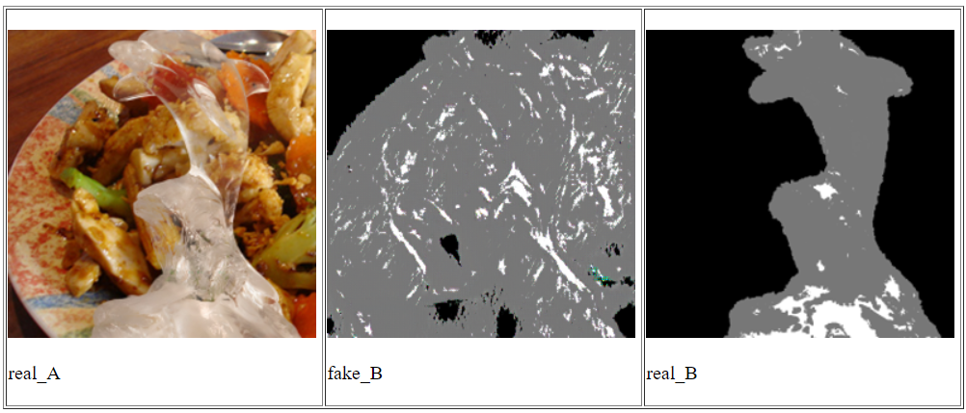
Future Work

Slide 20
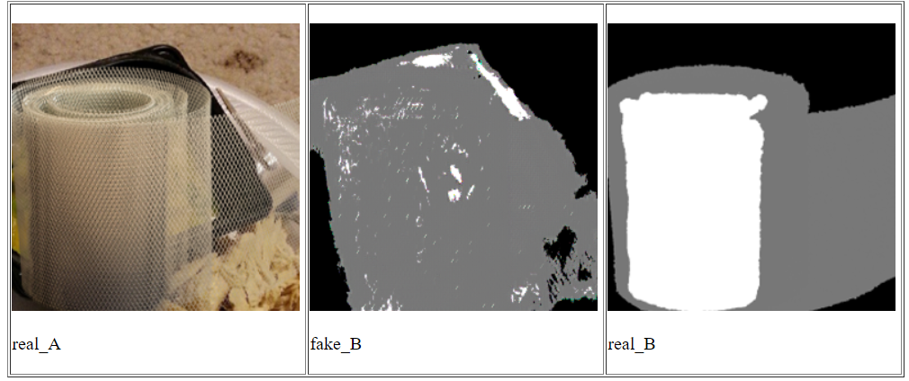
Future Work: Deep Video Matting

